Slide 1
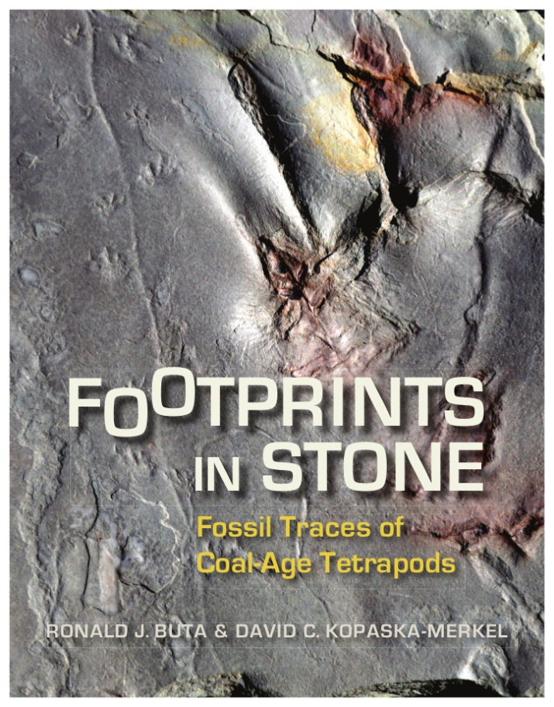
The Story Behind “Footprints in Stone: the Coming to Fruition of a Pipe Dream”
Ron Buta and David Kopaska-Merkel

Slide 2
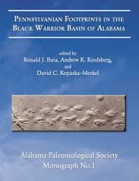
In July, 2005, the Alabama Paleontological Society (APS) published a monograph on the trace and plant fossils found at a Walker County surface coal mine, the former Union Chapel Mine.
This book was prepared mainly for knowledgeable amateur fossil collectors and professional paleontologists, but not necessarily for the general public. However, one chapter has this title:
“SAVING THE UNION CHAPEL MINE: HOW A GROUP OF DETERMINED AMATEURS TEAMED UP WITH PROFESSIONALS TO SAVE A WORLD-CLASS TRACKWAY SITE IN ALABAMA”
by T. PRESCOTT ATKINSON, RONALD J. BUTA, and DAVID C. KOPASKA-MERKEL
The “Blue Book”

Slide 3
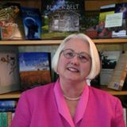
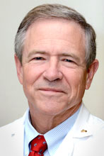
“SAVING THE UNION CHAPEL MINE” tells the story of how the Union Chapel Mine became the first state-protected fossil site in Alabama. This article caught the attention of Beth Motherwell, the natural history editor of the University of Alabama Press.
January 10, 2008: Beth Motherwell contacts APS officer Dr. T. Prescott Atkinson (Children’s Hospital, UAB), about a proposed book project.
What Beth wanted: “a distillation [of the UCM Monograph] that is understandable to all.”
This was the beginning of the “Footprints in Stone” project.

Slide 4
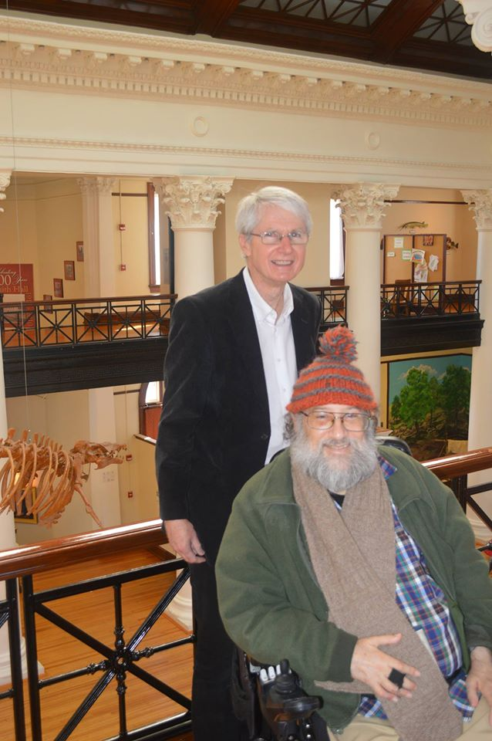
It took 8.5 years to go from Beth’s suggestion to the published book.
Initial idea, January 2008 → → →
Published book Jun 15, 2016
Authors: Buta & Kopaska-Merkel
How was this done?

Slide 5
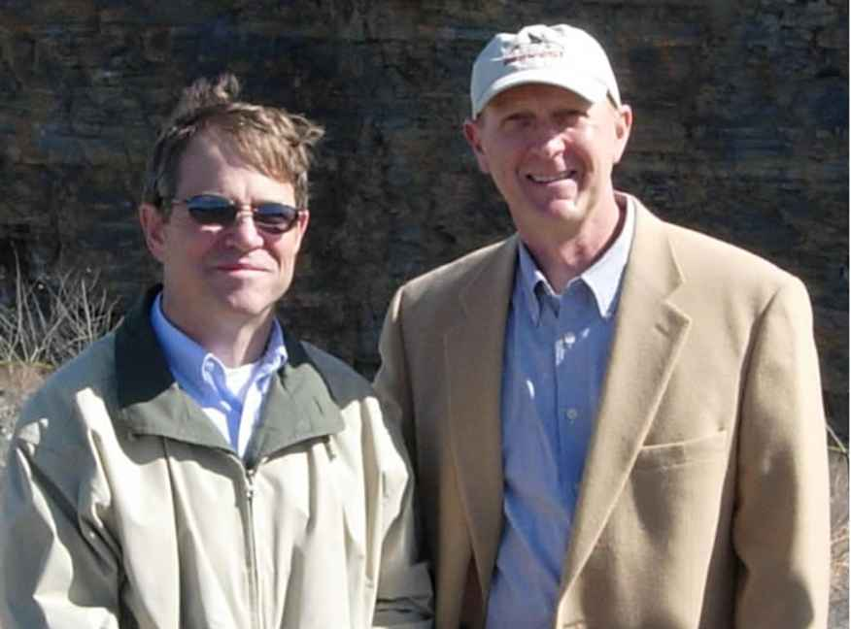
Timeline
February 22, 2008: Prescott has meeting of APS officers and members at his house in Birmingham to discuss the project. Ron Buta brings to the meeting a proposed outline for the book. After the meeting, Beth emails Prescott with this comment:
“I believe [the proposed book]will be a great asset for our state for many decades afterward. It will, of course, be a lot of work to produce for those involved but I believe the rewards in possibilities and satisfaction will be well worth the efforts of all. “
February 23, 2008: Prescott asks Jim Griggs, director of the State Lands Division of the DCNR and owner of the fossil site, if the proposed book was okay with him. Prescott tells him “Ron Buta and I would probably do most of the writing.” Jim agrees that the project would be very worthwhile.
Jim Griggs

Slide 6
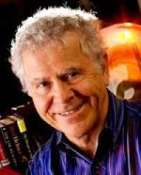
March 4, 2008: To get started, Beth suggested that we submit a proposed table of contents and an example chapter or two. Ron emails Prescott:
“I am thinking that as one of these preliminary chapters, we could test the idea of including an astronomical context…. This would allow us to put the 310 million year age of the fossils into a cosmic context, and is not something that is often done in books of this nature.” In response, Prescott says: “I like the idea of the astronomical angle - it would add a neat dimension to the book.”
March 22, 2008: By this time, Prescott and Ron are starting to have second thoughts about being the authors of the proposed book. They are not sure if they will have the time for it. Prescott proposes idea of seeking a local professional writer to do the book.
Believes that someone with name-drawing power would enhance sales of the book.
Possibilities considered:
Homer Hickam – famed author of Rocket Boys, and also a 2006 visitor to the UCM site
Although strongly interested in paleontology, Homer tells Prescott he can’t really take on the task at that time.

Slide 7
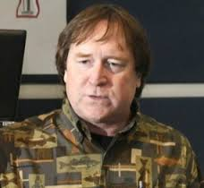
Other possibilities considered:
Thomas Spencer – wrote first article about Track Meet 1 in Bhm News (declined)
Kent Faulk – wrote another article for the Bhm News
Roger Reid – excellent writer for Discovering Alabama TV show
May 16, 2008: Of these, Roger Reid agrees to write the book.
However, Roger also has time constraints and focuses on writing a young person’s novel about the Minkin site. This charming novel, called Time, was published in January 2011.

Slide 8
August 9, 2009: More than a year goes by, and Ron and Prescott acknowledge that no progress has been made on the “distillation” book.
They propose to Beth that we consider asking Dr. David C. Kopaska-Merkel, Geological Survey of Alabama, to take the lead on writing the book. David brought numerous skills to the project:
experienced writer of poetry
science-inclined author who had previously written human interest stories and short novels
professional geologist/paleontologist
intimate knowledge of the project
In an email to Beth, Ron wrote that David “knows writing well and is probably the best writer who is already a part of our group.”
August 10, 2009: David enthusiastically agrees to write the book, but feels his time constraints would necessitate having a coauthor. Ron offers to be that coauthor, in part because Ron has a sabbatical period coming up in spring 2010.

Slide 9
This match-up obviously worked! Here is what we brought together to the project:
-both had intimate knowledge of virtually all aspects of the project
-both working scientists in academic settings
-both experienced in scientific and public writing
-although not a geologist, by 2009 Ron had 12 years experience in amateur paleontology
-both committed to public outreach
-both realistic about what it was going to take to convert a “pipe dream” into reality
Commitment and perseverance were the only way the project would ever see the light of day!

Slide 10
By August 13, 2009, a plan was put in motion to start the project. We would begin with a series of interviews, some in-person, some by email, and many by recorded phone conversations. The book would be constructed around these interviews and the rough outline provided by Ron at the February 22, 2008 meeting at Prescott’s house.
Interviewees:
Missy Minkin – wife of Steve Minkin
Jerry MacDonald – discoverer of Permian tracks in New Mexico
T. Prescott Atkinson – leader of the preservation effort
Ashley Allen - UCM site discoverer
John Southard – local resident of the UCM
Dolores Reid – former owner of New Acton Coal Company
Anthony J. (“Tony”) Martin – professional trace fossil specialist, Emory University
Jim Griggs – director of State Lands Division, Department of Conservation and Natural Resources
Spencer Lucas – Curator, New Mexico Museum of Natural History and Science
David Dilcher – Professor, Paleobotany, Florida State University and member, US National Academy of Sciences
Jun Ebersole – curator of paleontology, McWane Science Center, Birmingham
Kathy Twieg – president of Birmingham Paleontological Society (BPS) at time of UCM discoveries
Jim Lacefield – author of “Lost Worlds in Alabama Rocks: A Guide to the State’s Ancient Life and Landscape”
Nic Minter – University of Bristol, UK, trace fossil specialist and student
Hartmut Haubold – Professor, Martin Luther Unversity, Halle-Wittenberg, Germany
Jack Pashin – Sedimentologist, Geological Survey of Alabama
Donny Williams – foreman, Kansas No. 2 surface coal mine
W. F. Cobb III – grand son of W. F. Cobb, Sr., after whom “Cincosaurus cobbi” is named
Vicki Lais –BPS member

Slide 11
September 9, 2009: email from Ron to Ashley to announce the plan to the APS: “The tentative title of the book will be ‘Footprints in Stone: Tracking Alabama's Ancient Animals and Insects’…. We hope to have the book completed by March 2011, so there's no time like the present to get started on it.”
September 14, 2009: plan presented to APS
September 28, 2009-summer 2010: interviews carried out
September 29, 2011: first version submitted to UA Press
October 5, 2011: APS approves of having Sue Blackshear make paintings of UCM animals
October 11, 2011: first version sent to reviewers by Beth
January 17, 2012: reviews of first version received; major revisions required
February 7, 2013: revised version, a major rewrite, submitted to UA Press
May 13, 2013: revised version accepted by UA Press!

Slide 12
June 26, 2013: Ron learns of a UCM specimen at the ALMNH showing a small amphibian surface trackway next to a single large Attenosaurus undertrack. Ron suggests that we use this for the book cover!
July 15, 2013: contract signed
October 4, 2013: Ron asks about fundraising, but nothing definitive at that time
June 26, 2014: David asks about fundraising again; we learn again that no progress has been made, and nearly a year has passed since the contract was signed! We realize we (the authors) have to be pro-active about fundraising for our book.
June to July 15, 2014: Ron prepares two copies of a mockup of the book in latex format.
The mockup becomes a critical part of our fundraising plan. We need something tangible to show people.
~August 1, 2014: Ron walks with the mockup to Smith Hall to renew his museum membership, and notices that Randy MeCready’s (retiring director, ALMNH) office door is open. Ron talks to Randy about the need for the startup funds. Randy is familiar with the book and was very sympathetic to our cause and said he would discuss it with his coworkers.
Randy MeCready

Slide 13
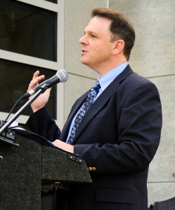
late August, 2014: Billy Field, who teaches a film class at the U. of A., learns of our fundraising problems and offers to have his class prepare a “kickstarter” film to raise funds.
August 26, 2014: David and Ron meet with Billy’s class, which has to choose among several projects. Four members of the class choose our project.
October 1, 2014: Bill Bomar, executive director of UA Muesums, informs us that the museum can contribute $5,000 to the start-up funds. This seed sets the stage for the rest of the funding coming through.
Billy Field decides the kickstarter film would seek $5,000 to make up the difference.
December 11, 2014: the kickstarter film is ready: https://vimeo.com/114215060
By this time, however, we had acquired $10,500 from several sources, including the ALMNH, McWane Center, the Alabama Geological Society, and several private individuals. This was sufficient to set the project in motion.
2015: much of the work during this time involved rights review, preparation and correction of the copy-edited manuscript, and the preparation of an index.
June 15, 2016: first copies of the published book received.
Bill Bomar

Slide 14
Other people involved in the project

Slide 15
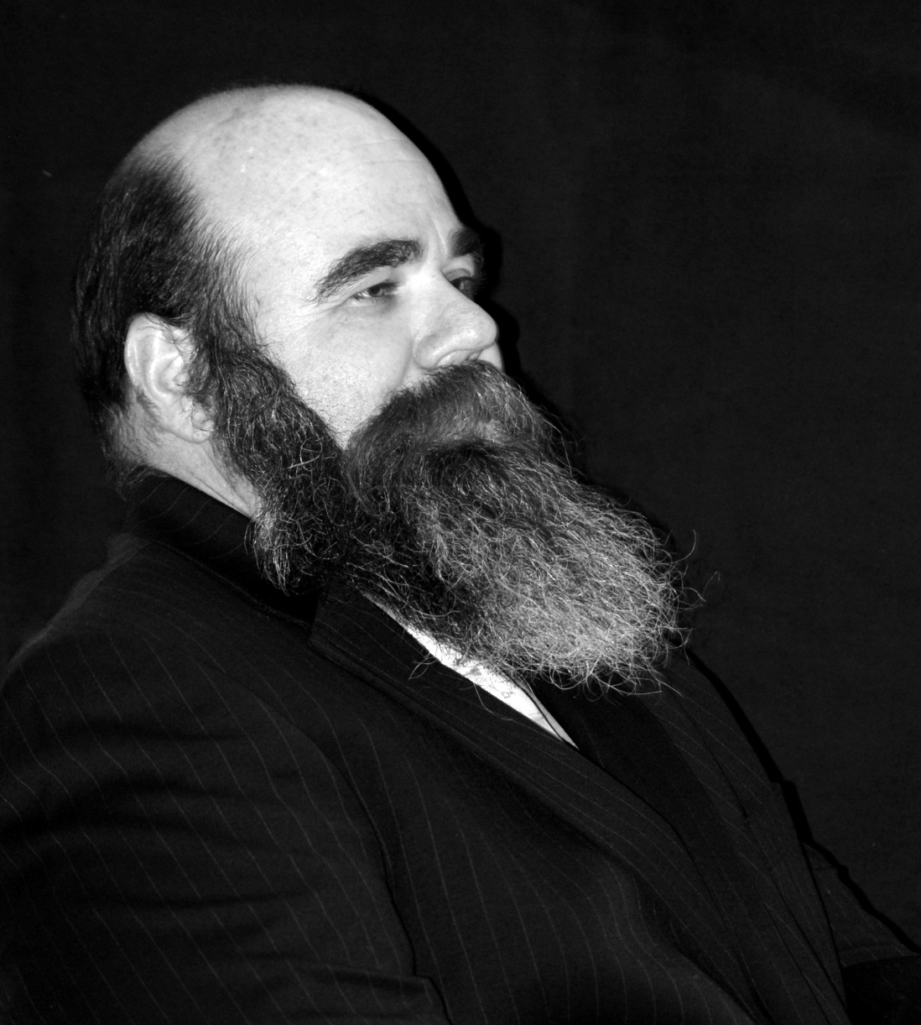
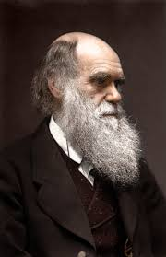
Ashley Allen Charles Darwin
Yahoo!
“It is not the strongest species that survive, nor the most intelligent, but the one most responsive to change.”

Slide 16
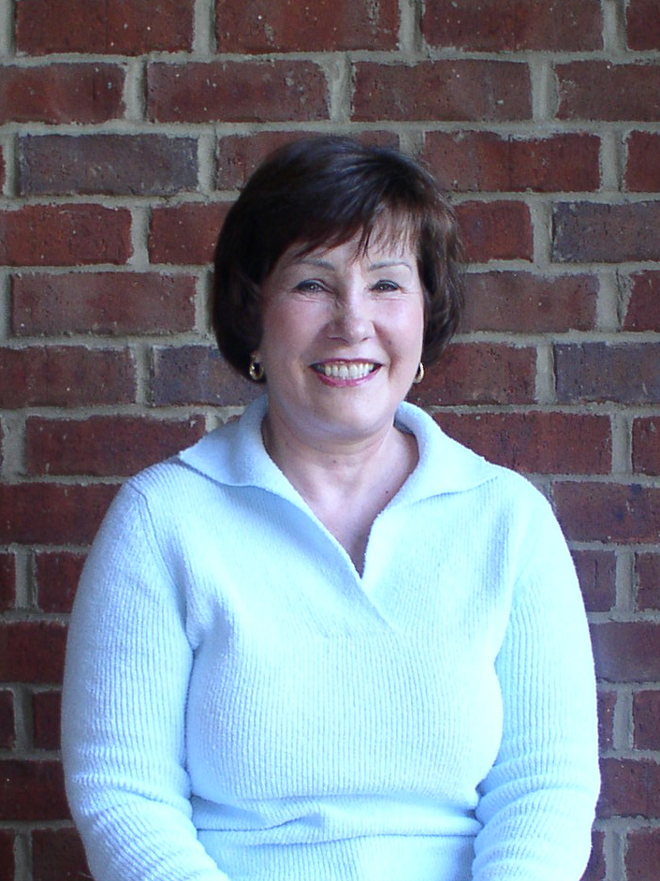
Dolores Reid, owner of New Acton Coal, the company that mined the Union Chapel Mine at the time of the BPS visits.
Without Mrs. Reid’s support, none of this would have been possible.

Slide 17
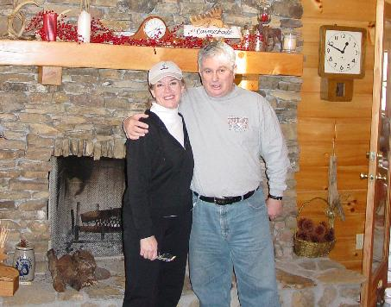
Steve and Missy Minkin 2001
Without Steve’s insight and tenacity, there would be no trackway database, no Union Chapel Monograph, and no “Footprints in Stone.”

Slide 18
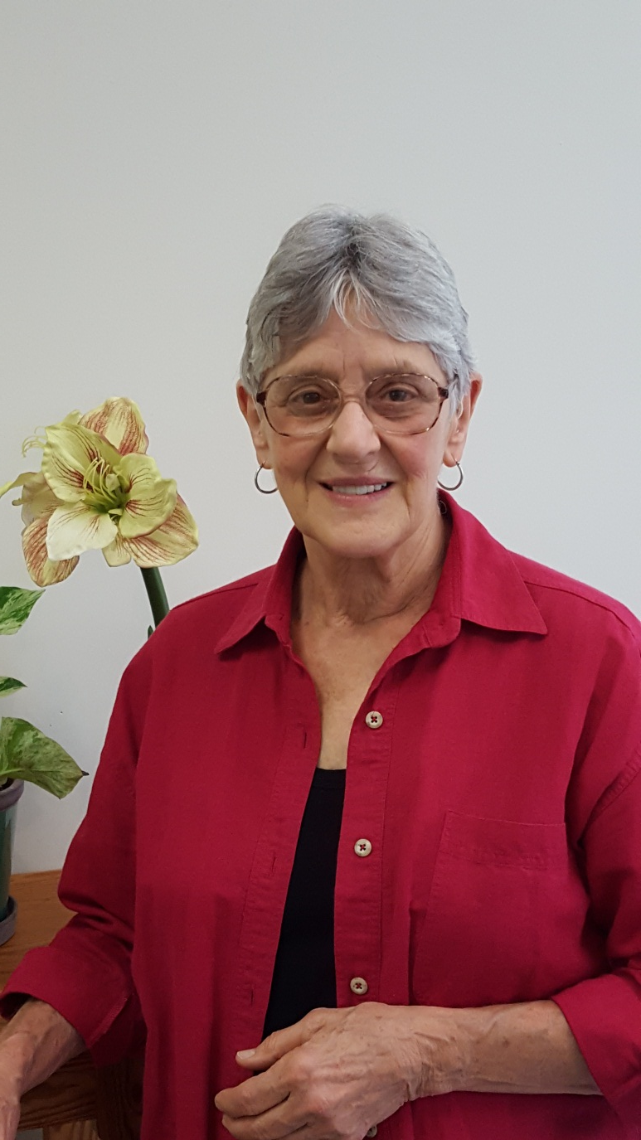
Sue Blackshear, Tuscaloosa artist who made the mysterious animals that left the footprints more alive and interesting, and who also made the revised version of the manuscript more acceptable to the reviewers.

Slide 19
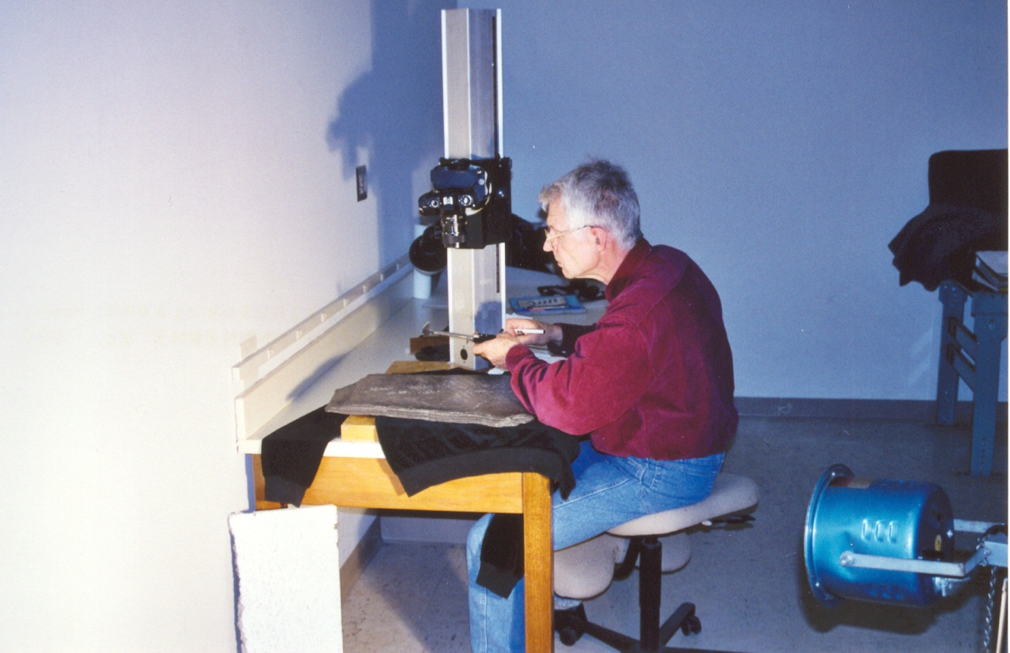
Prof. Dr. Hartmut Haubold, now retired professor of paleontology at Martin Luther University in Halle, Germany; first studied the vertebrate trackways from the UCM in detail and with a seriousness that was befitting of the material he was working with.
He contributed perhaps the most important papers in the UCM Monograph, and his contributions were the chief source for our discussions of vertebrate trace fossils in “Footprints in Stone.”

Slide 20
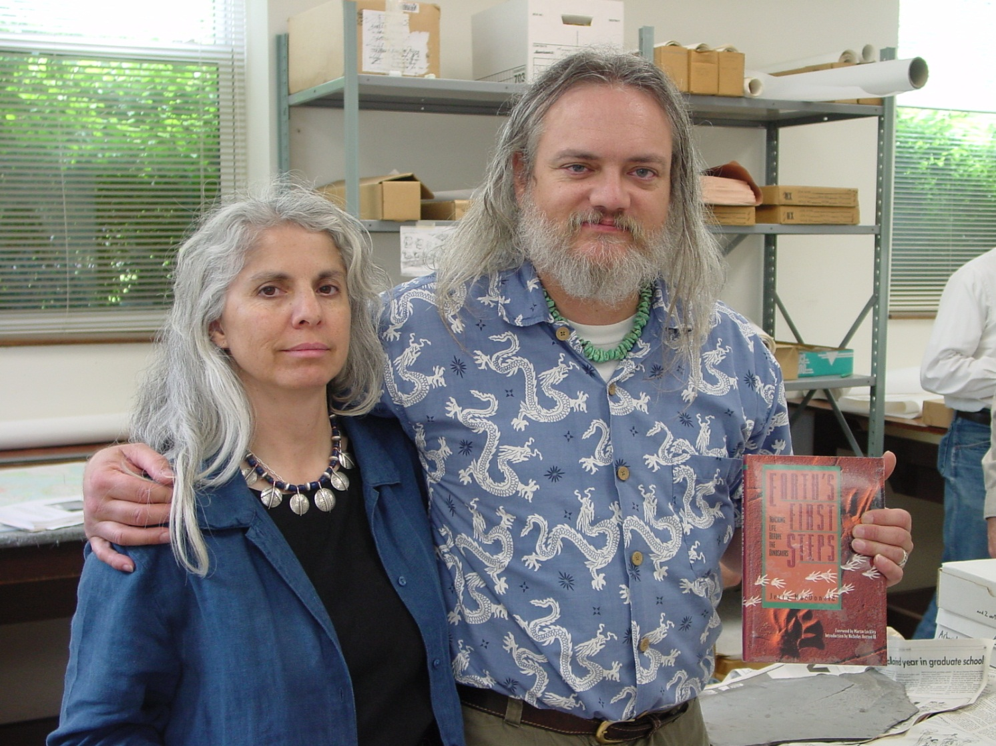
Jerry and Pearl MacDonald – In 1987 Jerry discovered spectacular Permian trackways in the Robledo Mountains of New Mexico. His story inspired our journey here in Alabama , and his support was crucial to the success of our efforts.
Jerry’s work and support are an important part of “Footprints in Stone.”

Slide 21
Dr. T. Prescott Atkinson – talented collector whose perseverance had a great deal to do with the success of the preservation effort.
Prescott took the lead on this important task , which is a significant part of the story told in “Footprints in Stone.”

Slide 22
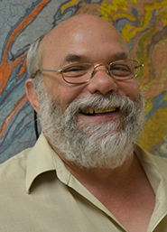
Dr. Jack C. Pashin, formerly of the Geological Survey of Alabama, now on the faculty of the Boone Pickens School of Geology, Oklahoma State University, was instrumental in determining what rock layers the Union Chapel fossils were coming from.
A professional sedimentologist, he also determined that tracks coming from the Carbon Hill area and the Union Chapel Mine (23 miles apart) were from the same stratigraphic interval, indicating a common age and the likelihood that a megatracksite exists in Alabama.

Slide 23
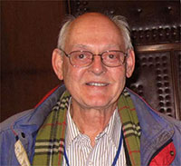
Dr. David L. Dilcher, formerly graduate research professor at the Florida Museum of Natural History, now at Indiana University, was instrumental in interpreting the plant fossils found at the Union Chapel Mine.
“Footprints in Stone” has a chapter on UCM plant fossils based on Professor Dilcher’s work, but this cannot replace the exquisite chapters he wrote for the UCM monograph.

Slide 24
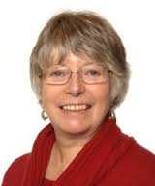
Professor Jennifer A. Clack, Emeritus Professor of Vertebrate Paleontology, Department of Zoology, University of Cambridge, UK. Author of the excellent book “Gaining Ground: the Origin and Evolution of Tetrapods” (2nd ed., 2012), Professor Clack allowed us to use several illustrations from her book in Chapter 4 of “Footprints in Stone.”
The artwork in Prof. Clack’s book also inspired the life-paintings made by Sue Blackshear.

Slide 25
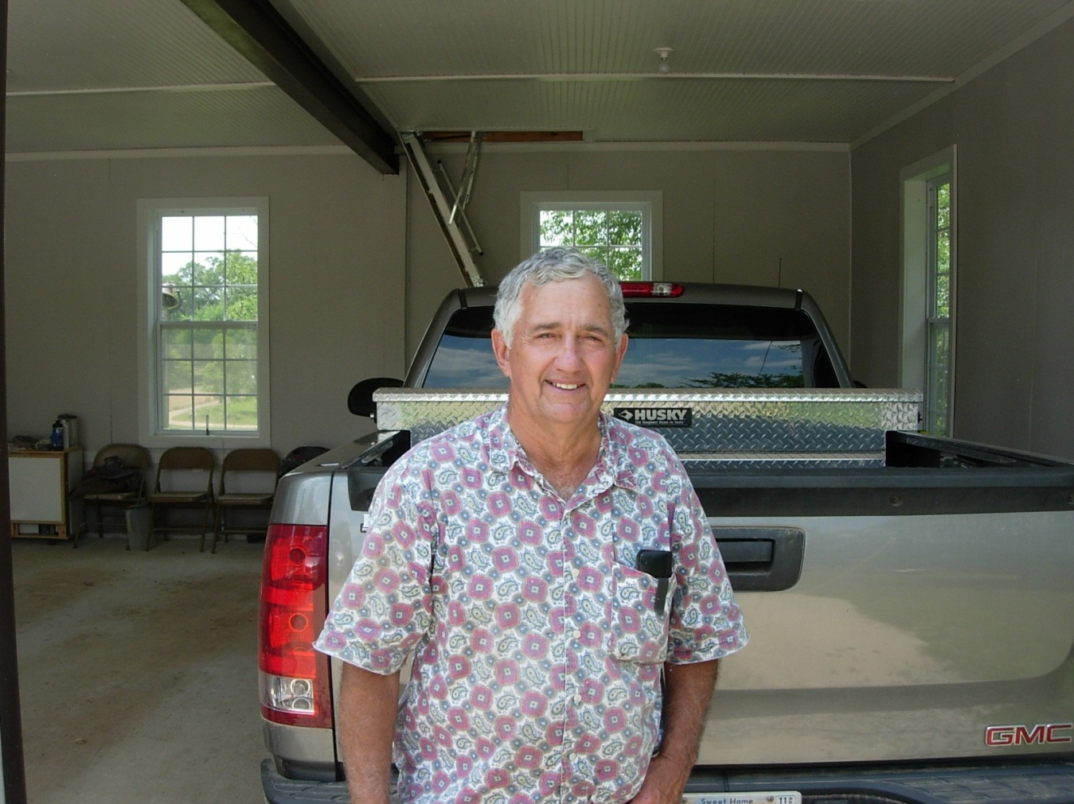
Mr. John L. Southard, local resident of the Union Chapel Mine who has lived his whole life in Union Chapel. In 2011, Mr. Southard took Ron on a historical tour of the area.
A chapter summarizing this history, which includes the marching of Union troops through the area in March 1865, was in the original submission of the book. However, it was dropped from the final version.

Slide 26
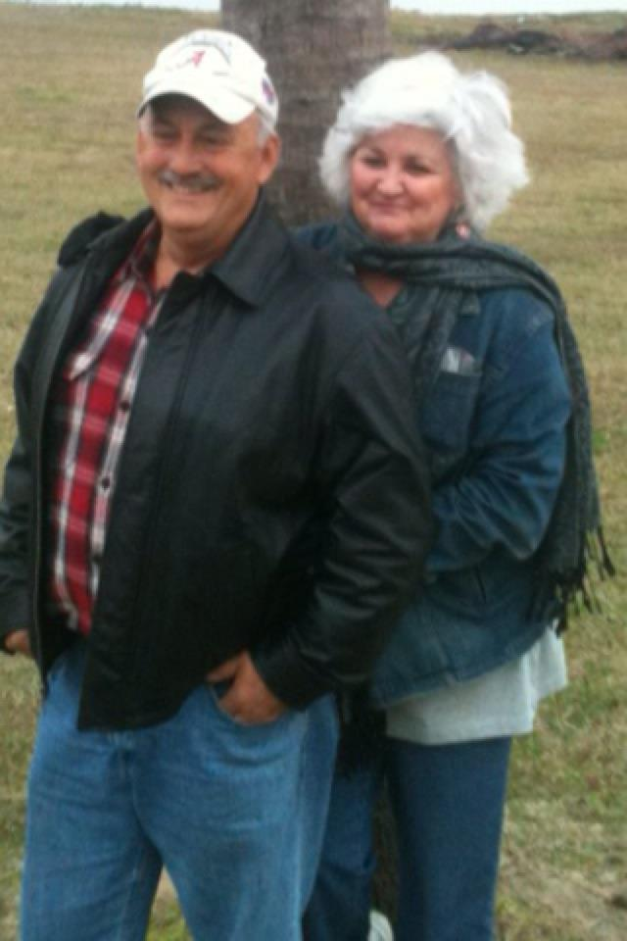
Leland Lowery was the foreman of the Crescent Valley Mine, located near Carbon Hill, when Ron visited the area in March 2011. Although Mr Lowery had seen tracks at the CVM and was curious about them, he did not know much about them. His wife, Janet Gayle Lowery, also became very interested in the tracks.
It was Mr. Lowery’s generosity in allowing Ron and Jack Pashin to visit the CVM that allowed this mine to become an important part of “Footprints in Stone,” and also led to Jack Pashin’s realization that Walker County likely hosts a “megatracksite.”

Slide 27
Four Memorable Quotes

Slide 28
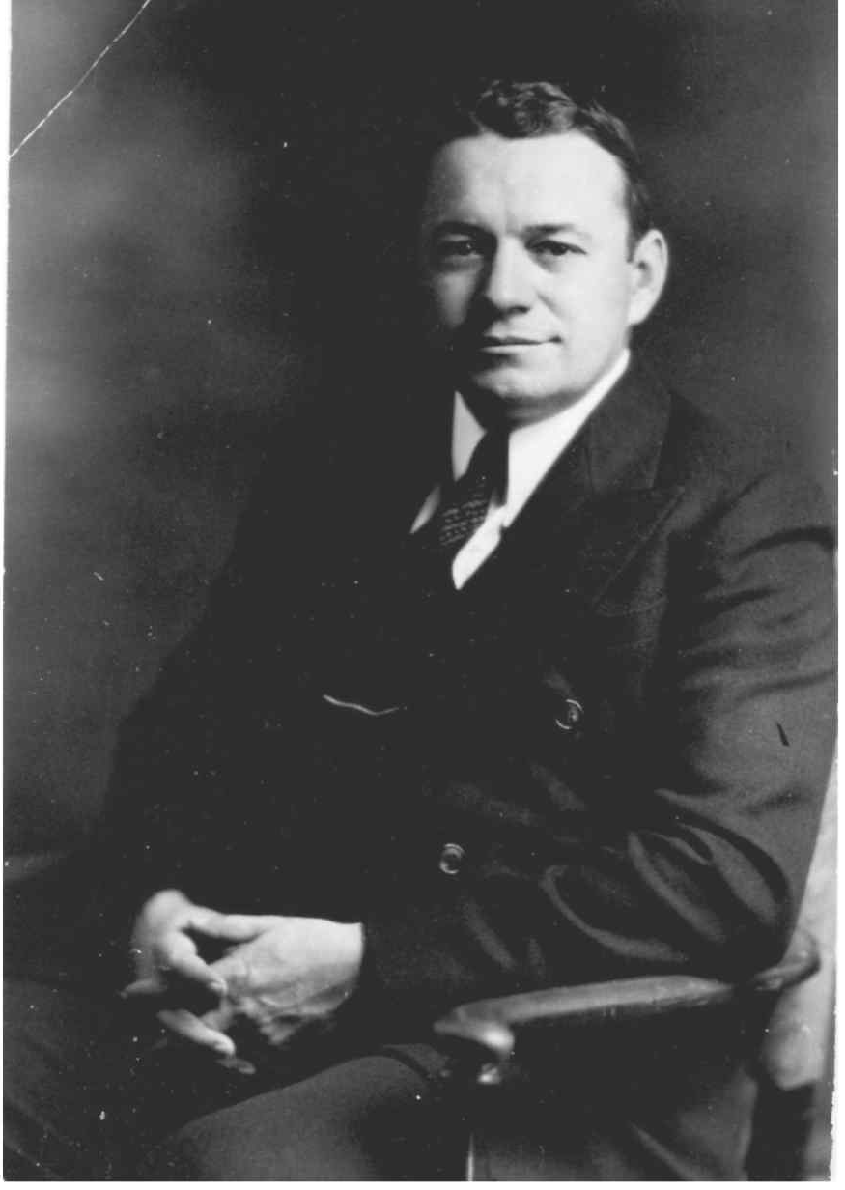
Walter B. Jones, State Geologist of Alabama 1927-1961: "They were somewhat startled to behold the trail of the animal leading for some forty feet along the roof of the slope, until it disappeared into solid rock." (Aldrich & Jones 1930, Museum Paper No. 9).

Slide 29
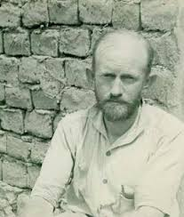
George Gaylord Simpson (1902-1984), associate curator of paleontology, American Museum of Natural History, New York: "A day spent weirdly and unsupported by the solace of tobacco in the depths of a coal mine, looking for the footprints of animals dead since 250,000,000 B.C.“
(January 1930, from Simple Curiosity: Letters from George Gaylord Simpson to family, 1921-1970, L. F. Laporte, ed., Berkeley: University of California Press, 1987).

Slide 30
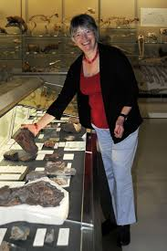
Prof. Jennifer A. Clack, Reader in Vertebrate Paleontology and Senior Assistant Curator, University Museum of Zoology, Cambridge, UK: "It is during the Westphalian that the first remains of animals that can confidently be called reptiles are found...“
(from Gaining Ground: The Origin and Evolution of Tetrapods, Indiana University Press, 2002)
The Westphalian A stage, 313 million years ago, of the Pennsylvanian period matches perfectly to the age of our Walker County trace fossils, implying that the Alabama footprints were made by some of the earliest reptiles that ever lived.

Slide 31
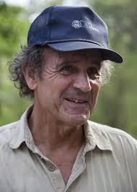
Doug Phillips: "Stars in a sense are the fossils of heaven, taking us into the antiquity of the cosmos. But for all their shining glory, they have yet to reveal the most astounding manifestation of the Universe. They have yet to reveal the footprint of life. For that we have to look at a very small but very significant plot of land in Alabama."
(Discovering Alabama, Episode 56: Tracks Across Time, 2005)

Slide 32
UNANSWERED
QUESTIONS

Slide 33
“Footprints in Stone” is a status update for the Minkin site.
The next 15 years: more exciting than the first.
Here are just a few things we don't know

Slide 34
Population dynamics

Slide 35
Large data sets for common species
Population dynamics
Gait analysis
Individual variations

Slide 36
How many species?

Slide 37
Arborichnus
*maker
*behavior
*growth

Slide 38
Arborichnus are typically clustered
Size is usually uniform
Who made it and what were they doing?

Slide 39
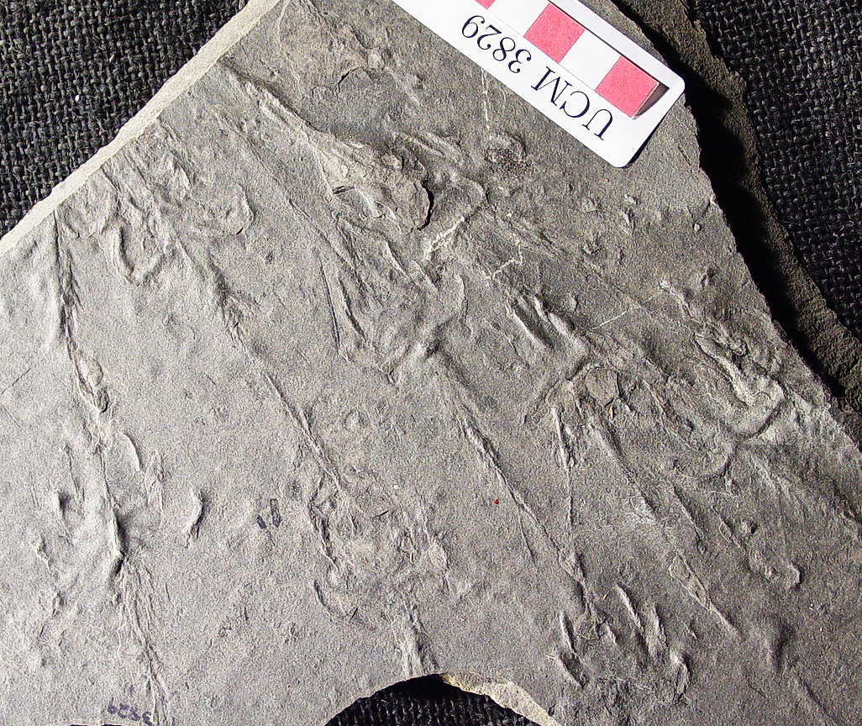
Group behavior

Slide 40
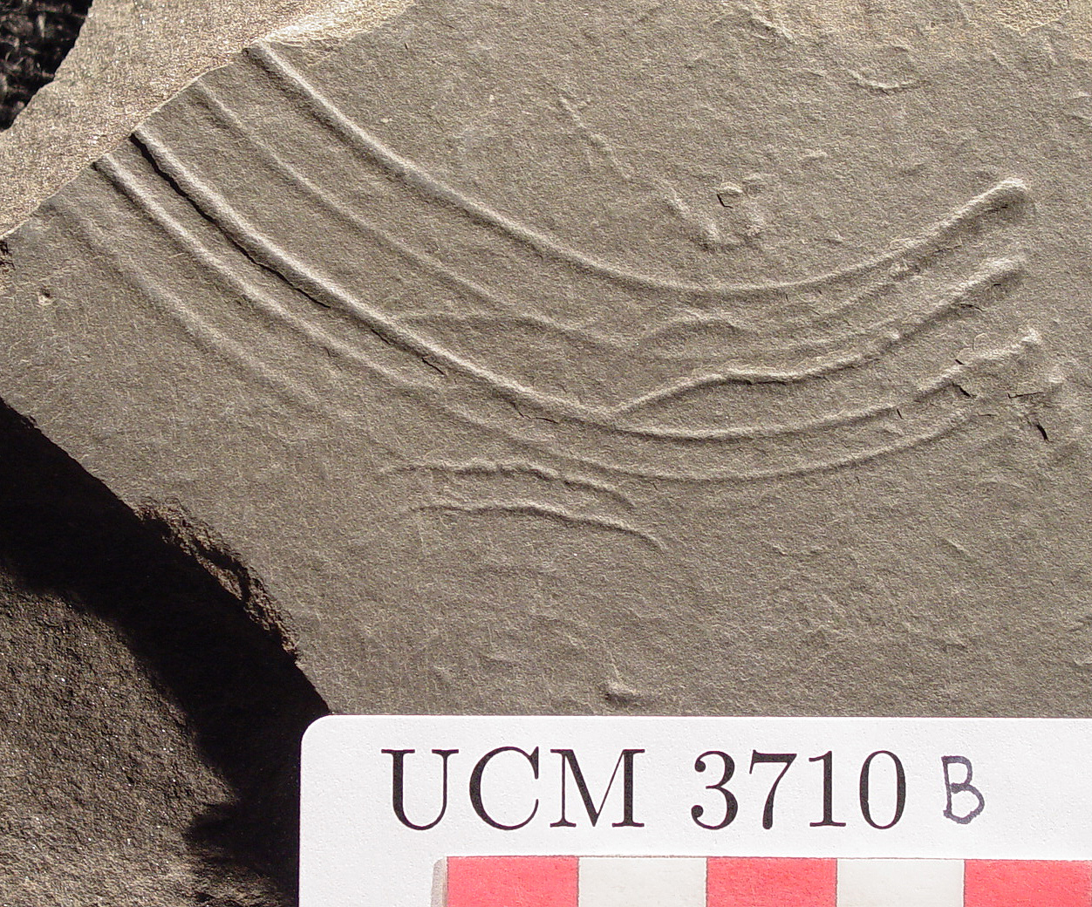

Slide 41
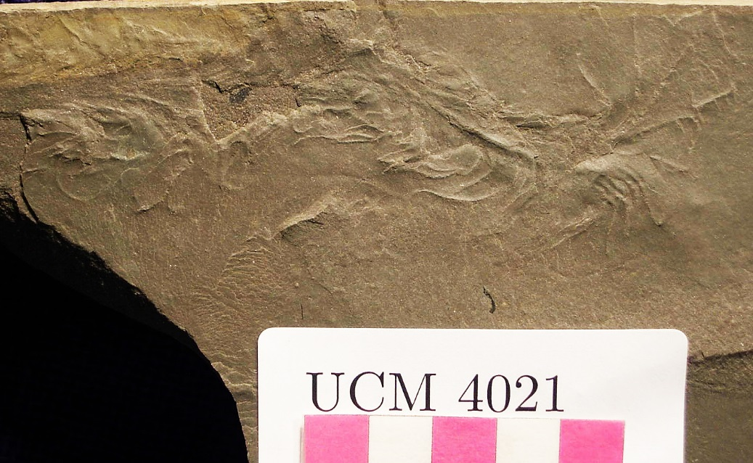

Slide 42
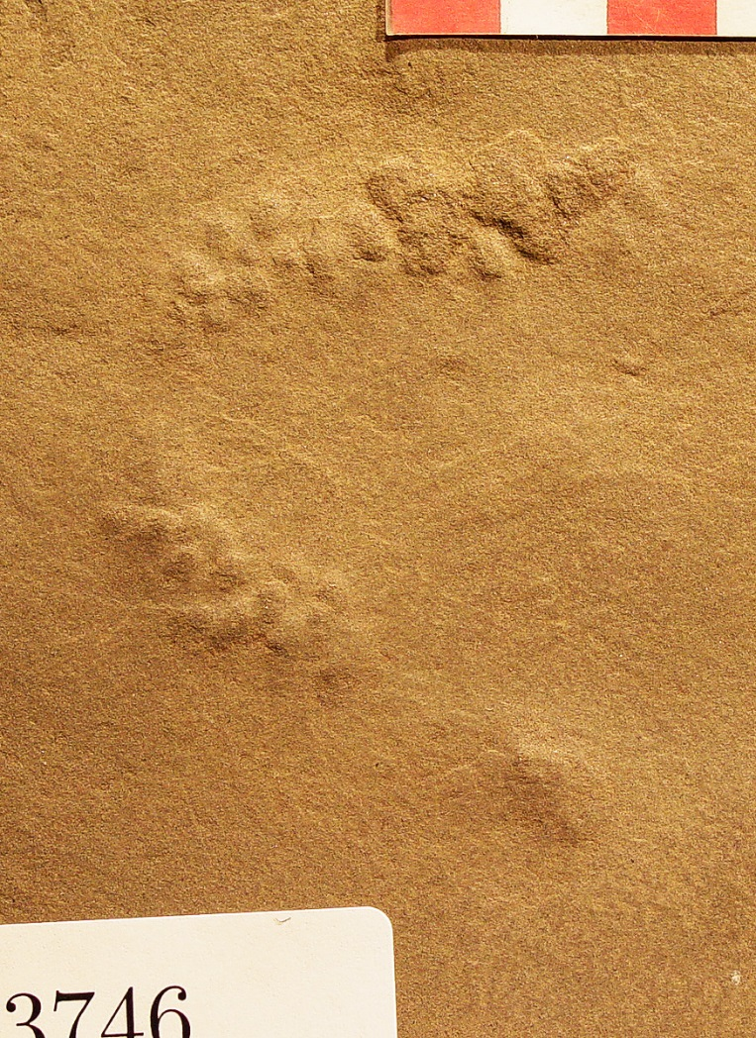
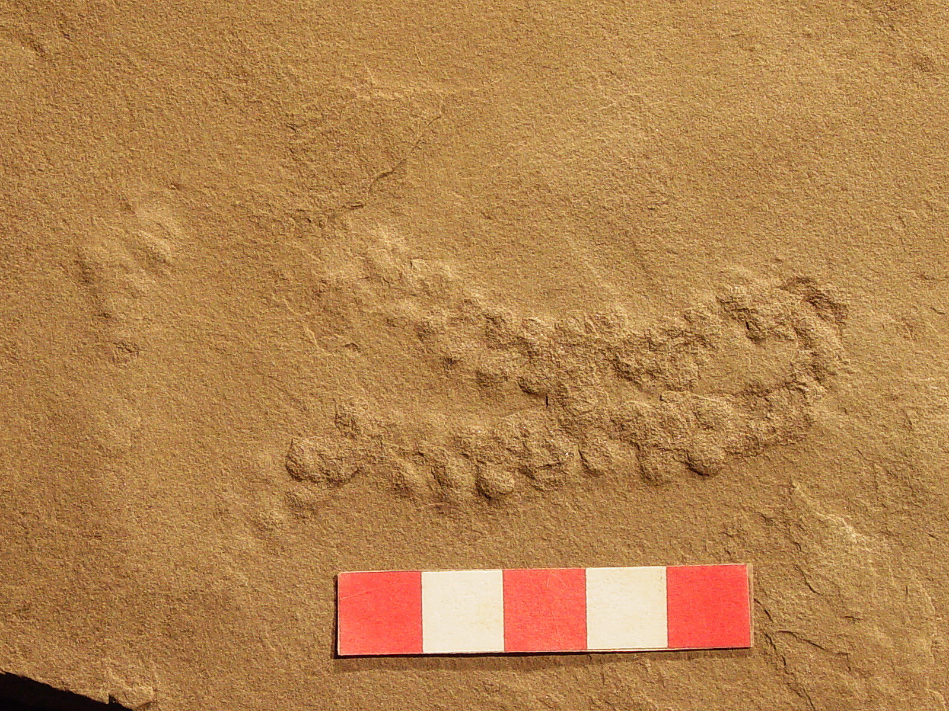

Slide 43
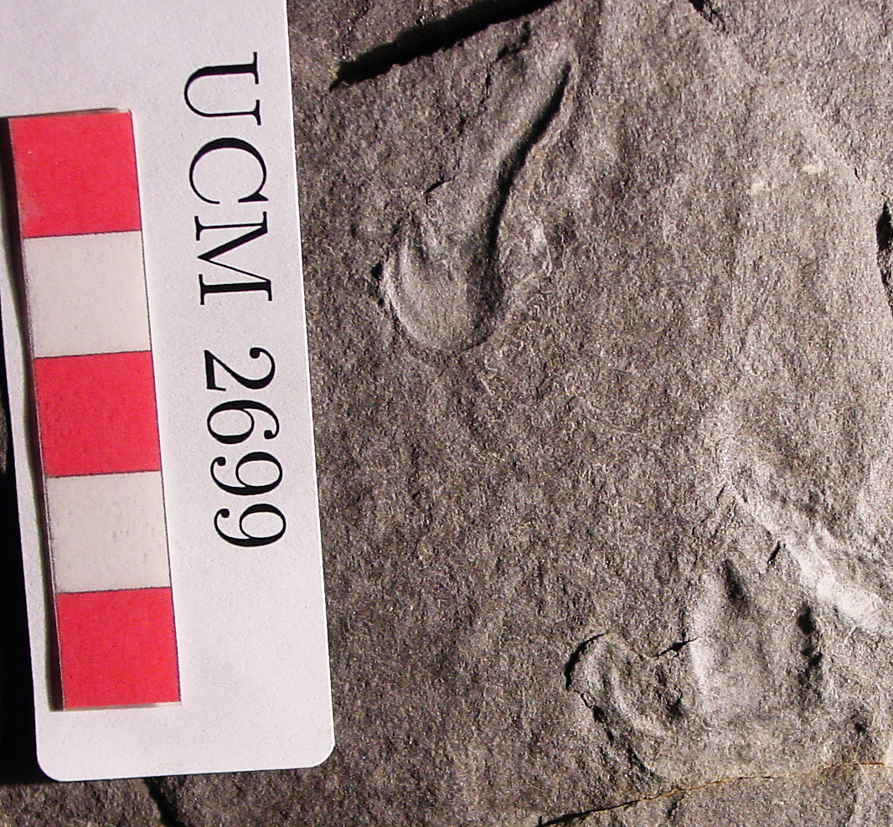

Slide 44
Future of the Minkin site
New discoveries
McWane Center holdings online
Scholarly research
More important than ever

Slide 45
Thank You!
We would like to thank the Alabama Paleontological Society for its continuous support during the many ups and downs of this project over such a long period of time, and we especially hope you all feel that the book does justice to Steve Minkin’s memory, Beth Motherwell’s idea, and to our collective experience as an organization with the wonderful trace fossils of Alabama!

Slide 46
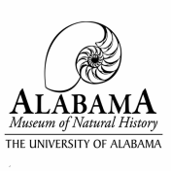
Announcement
Footprints in Stone Book Reception & Signing
Location: Smith Hall, Alabama Museum of Natural History
Date: Sept 9th, 2016
Time: 6-8 PM
Footprints in Stone Book Reception & Signing - Sept 9th 6-8 PM “This long-awaited publication by Ron Buta and David Kopaska-Merkel tells the story of the preservation of the Union Chapel Mine as the Steven C. Minkin Paleozoic Footprint Site. Following a long and suspense-filled campaign by the Alabama Paleontological Society during which it seemed that this priceless Carboniferous track site might be obliterated under the requirements of federal legislation, the site was taken into the State Lands of the Alabama Department of Conservation and Natural Resources in 2004 and has since been available for field trips by schools, university classes, and other natural history-related organizations. Footprints in Stone tells the story of the world’s most prolific Carboniferous trackway site and the people who helped preserve it.” – from Museum website

